Slide 1
Radon Education
FOR B.C. YOUTH

Slide 2
In the troposphere where we breathe there are gases that are safe for humans and gases that are not.
Notes:
GRAPHIC DESIGNER
NOTE – Please find pictures unless stated otherwise - these are just to show you what to look for.
We have used a few free pictures from here: https://pixabay.com/users/takeactiononradon-18149510/

Slide 3
The gases on the following slides are naturally occurring but are they safe to breathe?
Gases
Nitrogen
Oxygen
Argon
Carbon Dioxide
Radon
Helium
Methane

Slide 4
Oxygen
O
2
It is a colourless and odourless gas that we breathe.
Notes:
Not harmful

Slide 5
Ozone
O
3
It is a pale blue gas with a distinctively pungent smell.
Notes:
harmful

Slide 6
Carbon
Dioxide
2
CO
It is a colourless and odourless gas produced by respiration and combustion.
Notes:
Not harmful

Slide 7
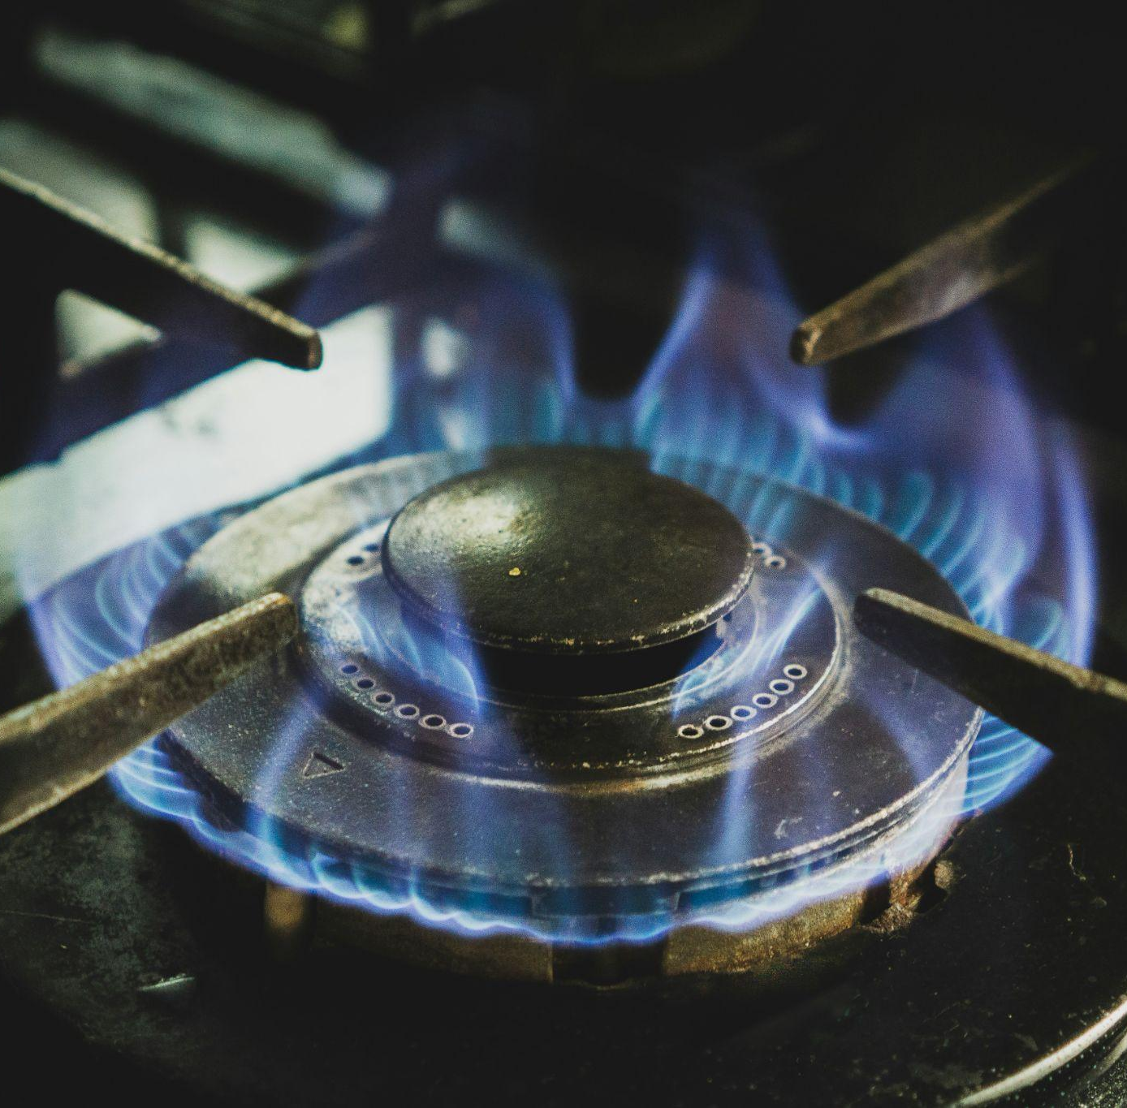
Carbon
Monoxide
CO
It is a colourless and odourless toxic gas.
Notes:
harmful

Slide 8
Radon
Rn
It is a colourless, odourless, radioactive noble gas.
Notes:
harmful

Slide 9
Video: What is radon gas?
https://youtu.be/d4fdWKCViBA

Slide 10
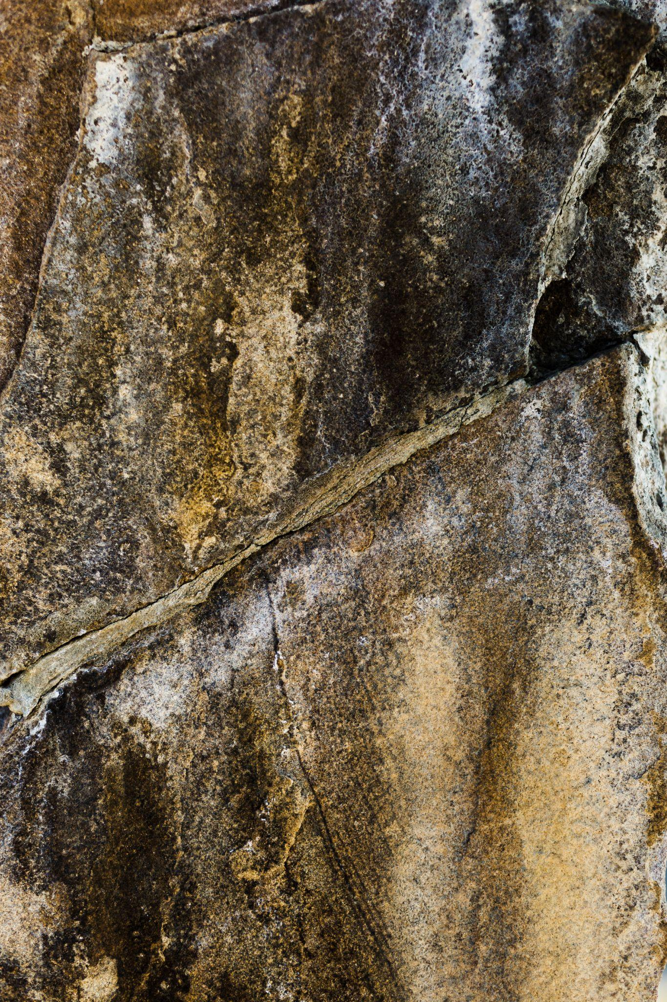
What is radon gas?
a) When uranium in soil, rock and water breaks down it releases radon gas.
b) Radon gas escapes from the ground into the air outside or into buildings in contact with the ground.
c) When radon gas is released into the air outside it doesn’t cause a problem as the air dilutes the radon.
d) When radon seeps into a closed-in space like a building or home, it can be harmful.

Slide 11
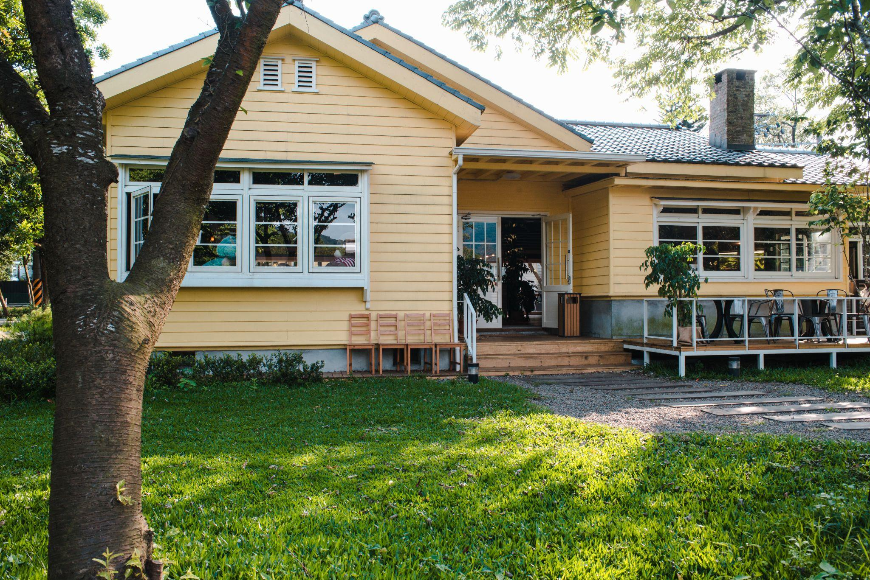
What is radon gas?
e) Once indoors, radon decays into tiny radioactive particles.
f) You and your family may be breathing high levels of radon without knowing it.
g) Inhaling these radioactive particles can damage cells that line your lungs.
h) If you breathe radon gas over a long period of time, it can lead to lung cancer.

Slide 12
Radon on the move?
In small groups experiment to discover:
Where radon is found in B.C.
Which soil types allow radon to escape more easily.
How groundwater can affect the escape of radon.

Slide 13
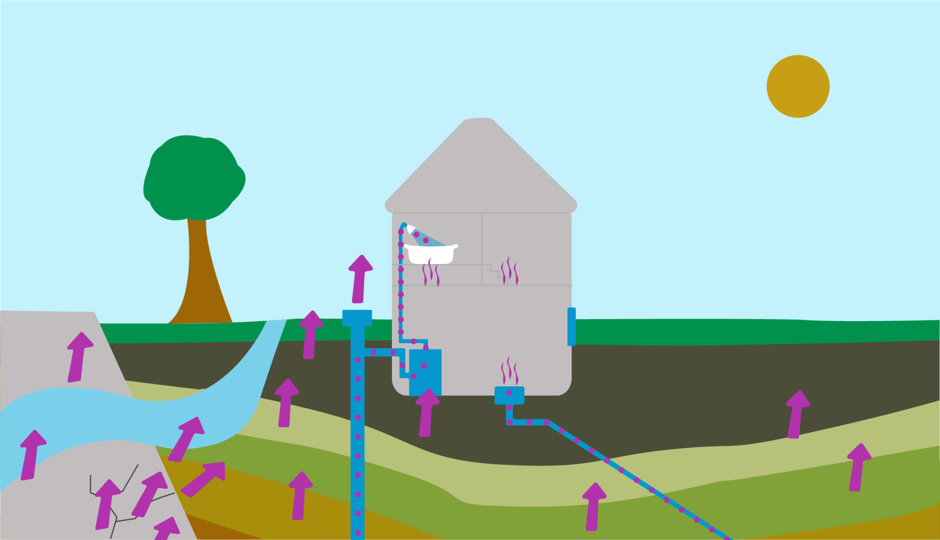
How does radon get from the ground into our homes?
The air pressure inside your home is usually lower than in the soil surrounding the foundation. This difference in pressure draws air and other gases, including radon, from the soil into your home.
Radon is drawn in through
cracks in foundation walls and floor slabs
construction joints
gaps around service pipes
support posts
floor drains
sumps
cavities inside walls
Exposure to high levels of radon indoors with long-term exposure affects our health.
Notes:
Image https://bclung.ca/radon – can we get permission to use?

Slide 14
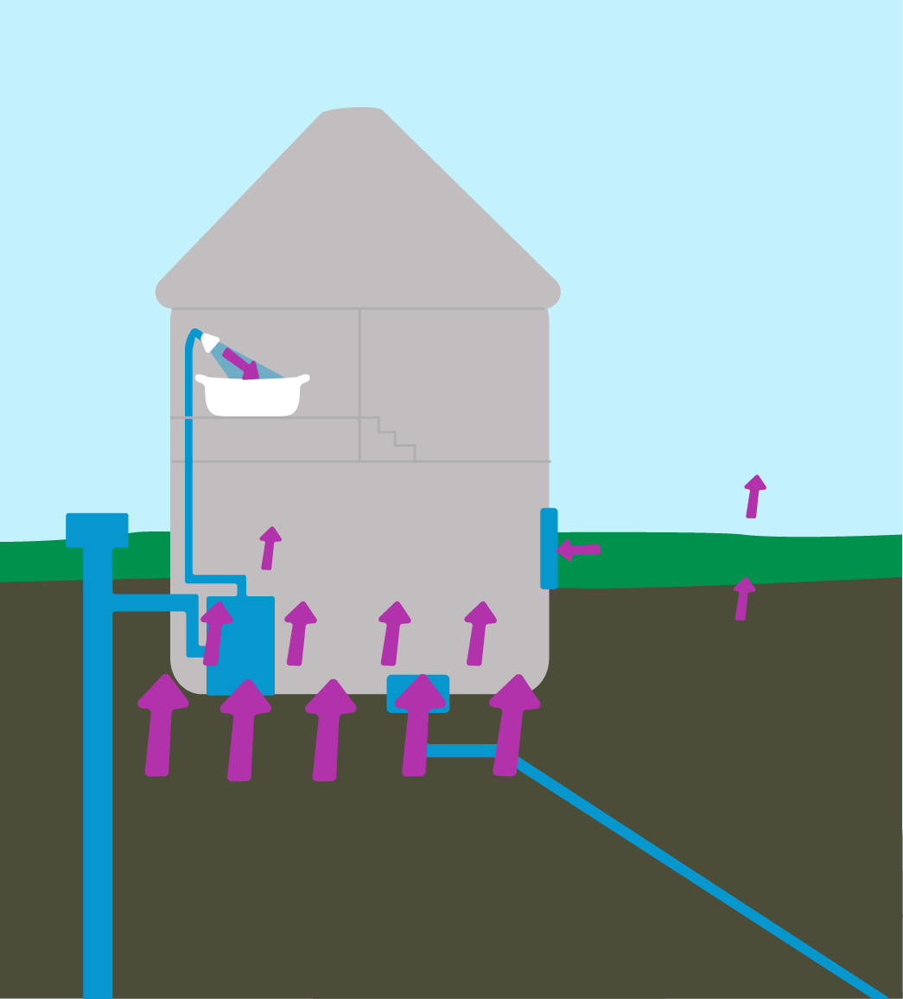
Where are the highest concentrations of radon?
The highest concentrations of radon occur on the floors closest to the ground, such as basements or ground level.
While radon is typically highest in the lowest level of the home, home ventilation systems can circulate air effectively and higher levels of radon have been found in upper levels of homes as well.

Slide 15
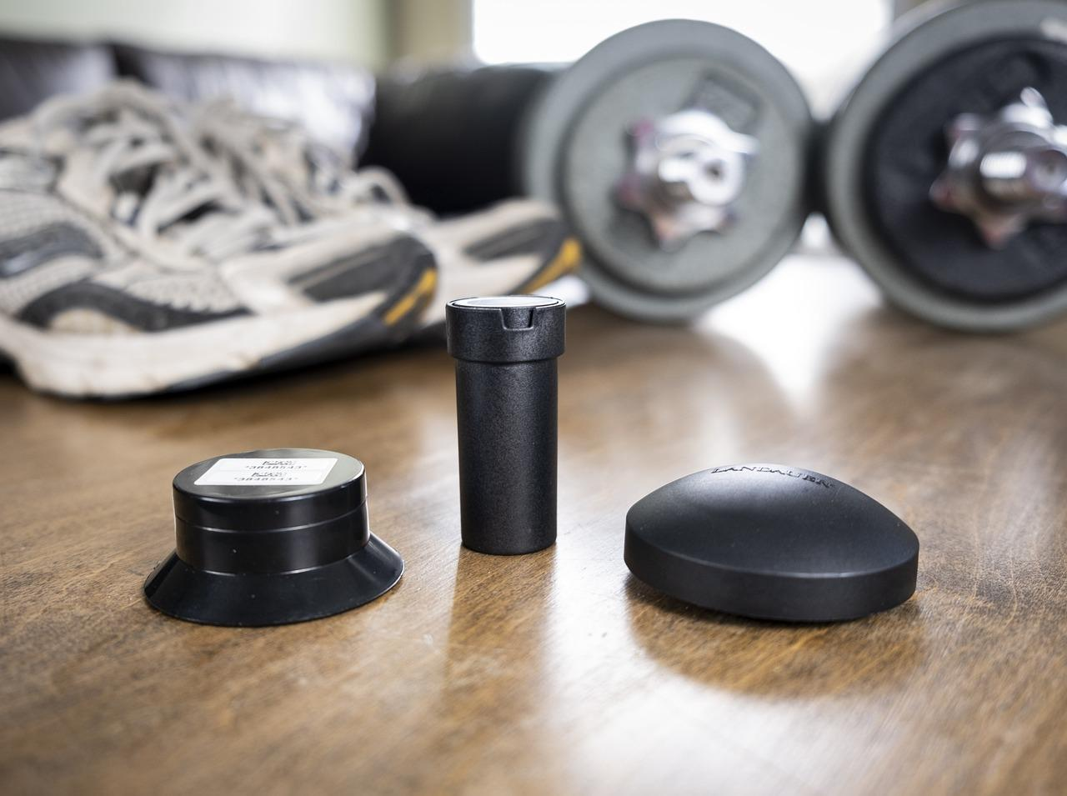
How do I know if radon is in my home?
Radon is invisible
The only way to know is by testing
Radon test kits
Notes:
Image from https://bclung.ca/radon-detector-library-lending-program

Slide 16
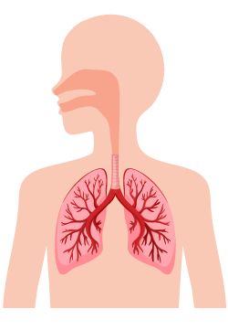
Health impacts
What can cause lung cancer?
Think | Pair | Share

Slide 17
Health impacts
Long-term exposure to high levels of radon* for non-smokers is the:
#1 cause of lung cancer
* Above 200Bq/m³
Notes:
Image from
https://www.canada.ca/en/health-canada/services/publications/health-risks-safety/radon-gas-causes-lung-cancer.html

Slide 18
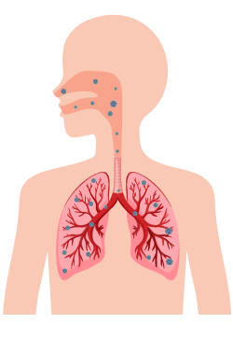
How does radon cause cancer?
When radon gas is inhaled into the lungs it decays into radioactive particles that release small bursts of energy.
This energy is absorbed by nearby lung tissue, damaging the lung cells.
When cells are damaged, they have the potential to result in cancer when they reproduce.

Slide 19
Video: How does Radon cause cancer?
https://www.youtube.com/watch?v=inG1g9PlqV4

Slide 20
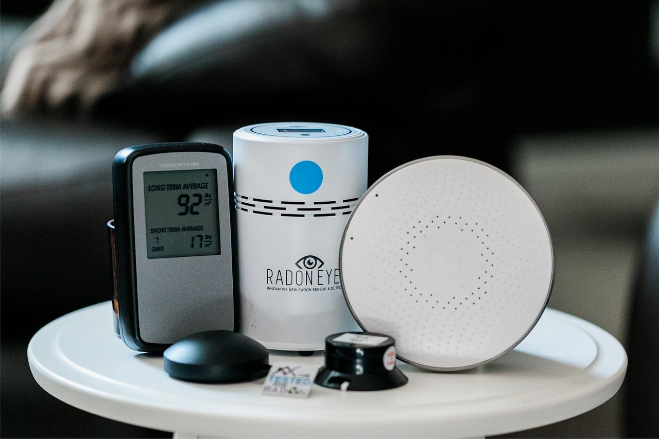
Testing for radon
Testing is done long-term, over 3 months, ideally when it’s cold and windows are closed, ideally during fall and winter.
Why is testing for radon preferable in the winter?
Radon test kits
Answer: In colder weather, windows and doors are closed, so this is the time of highest concentration.

Slide 21
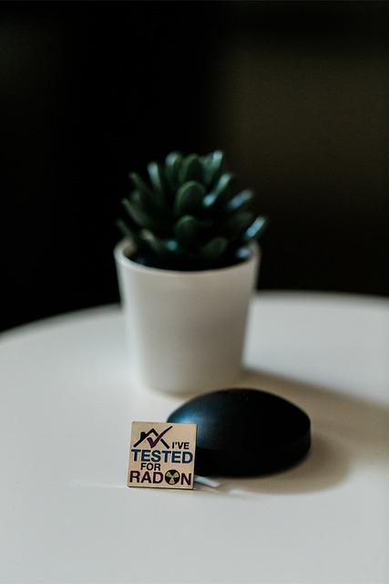
Measuring radon
Radon is measured in Becquerels per cubic meter (Bq/ m³ ).
Bq is used to measure radioactivity, which is the amount of ionizing radiation released when an element, like uranium, emits energy through radioactive decay of an unstable atom.
The Canadian Guideline level for radon is 200 Bq/ m³. Radon levels above 200 need to be reduced.
Notes:
Citation nrc.gov/reading-rm/basic-ref/glossary/becquerel-bq.html

Slide 22
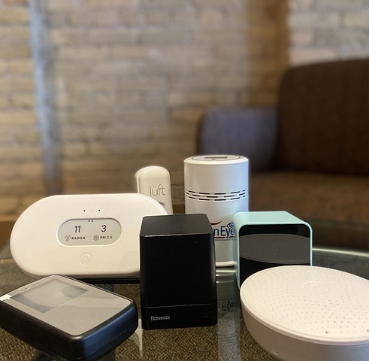
Testing for radon
You can purchase a do-it-yourself radon test kit OR hire a radon measurement professional
2. Do a long-term test for at least 3 months (91days)
3. Once you receive your kit, follow the instructions carefully.
*Go to Take Action on Radon website to find approved kits and services https://takeactiononradon.ca/test-for-radon/
Or check out your local library to see if they have kits for loan. Local libraries only have the digital radon monitors, which is for screening purposes. It is recommended to follow up screening with a 3 month long-term radon testing for a more comprehensive assessment.

Slide 23
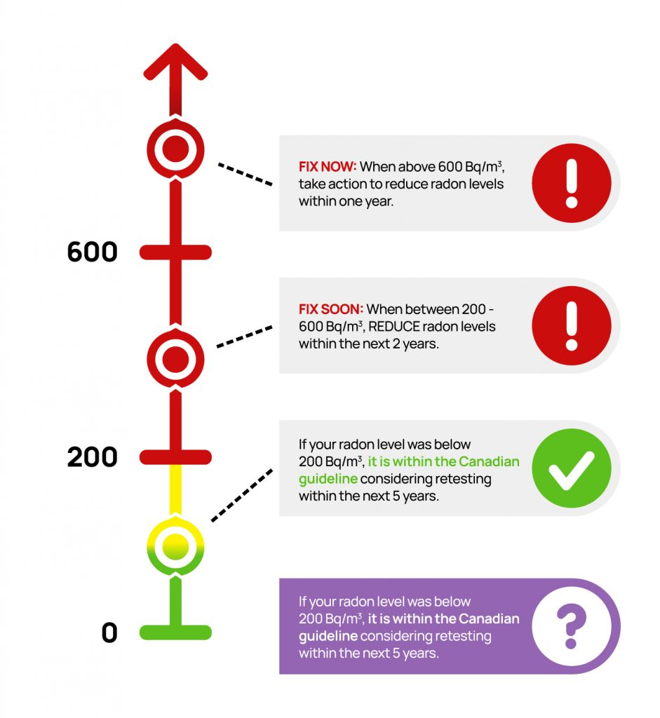
Interpret the results
If your radon level is below 200Bq/m³
NO action is required.
For radon levels above 200Bq/m³ TAKE ACTION to reduce.
Notes:
Image from https://takeactiononradon.ca/test-for-radon/understanding-your-radon-test-report/
Can we use this image?

Slide 24
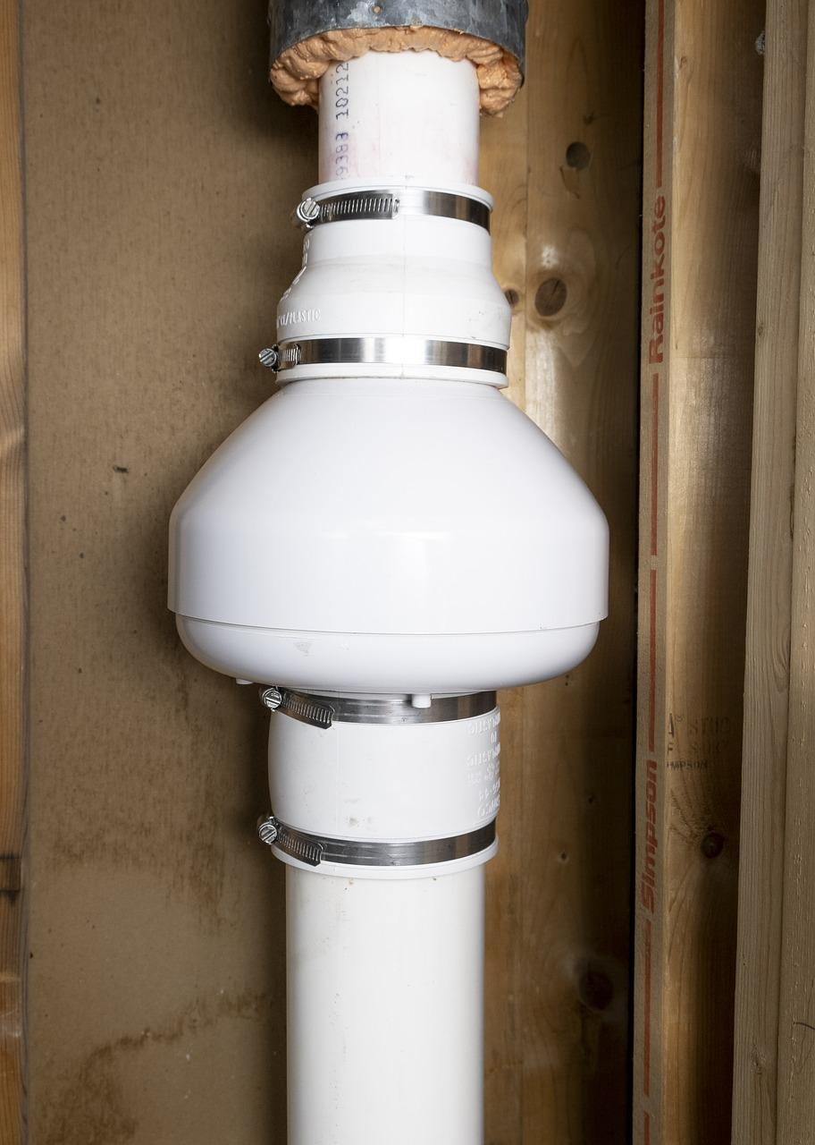
Radon mitigation
Techniques to lower radon levels are effective and can save lives. A radon mitigation system can be installed in less than a day and in most homes will reduce the radon level by more than 80-90%.
The most common radon reduction method is called Active Soil Depressurization (ASD).
A pipe is installed through the foundation and connected to an outside wall or up through to the roof line.
A small fan is attached which draws air and the radon from below the house and exhausts it outside.
A certified* radon mitigation professional can usually install a mitigation system in one day.
An ASD (active soil depressurization system being installed in a basement)
Notes:
Image from
https://takeactiononradon.ca/protect/reducing-radon/

Slide 25
Video: Radon mitigation
https://www.canada.ca/en/health-canada/services/video/radon-what-you-need-to-know.html
Funding to offset the cost of mitigation: go to https://takeactiononradon.ca/protect/reducing-radon/

Slide 26
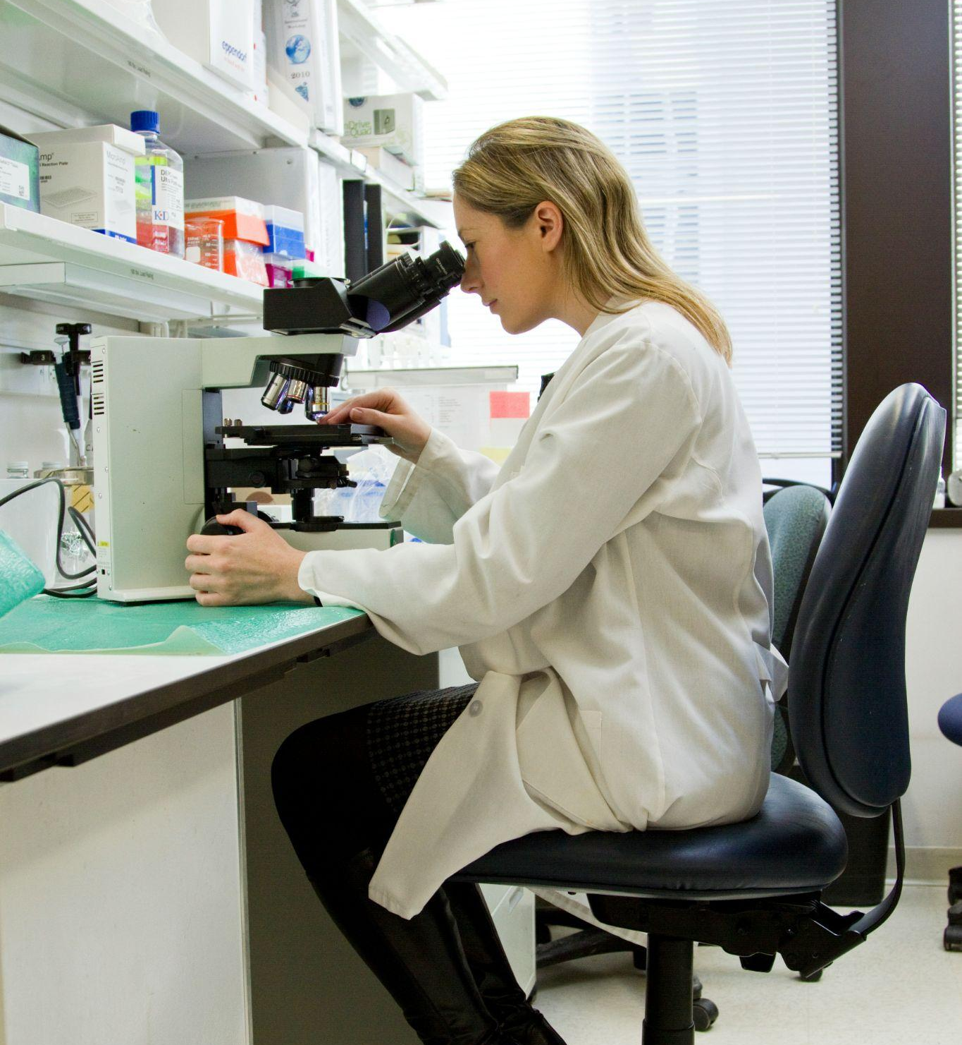
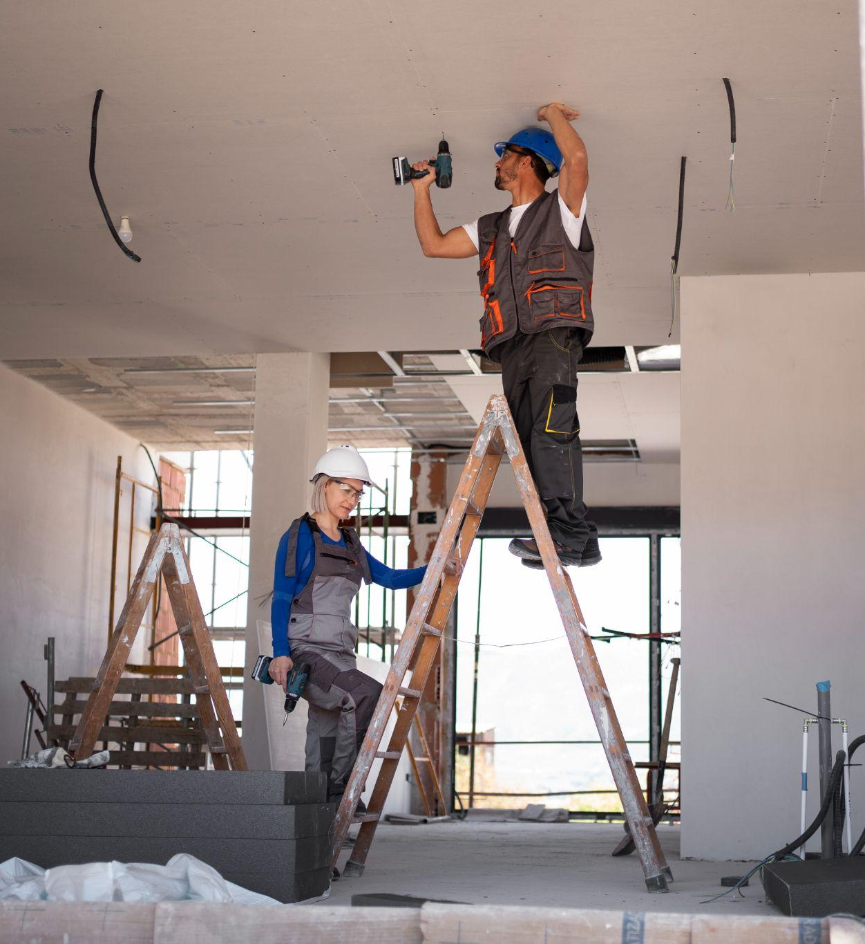
Careers in Radon
On handout, match career titles with the descriptions to learn about careers related to radon.

Slide 27
Careers in Radon
Growing awareness of the risks of radon means that there are opportunities for various related careers such as:
Mitigation professionals*
Researchers
Laboratory technicians
Policy analysts (government)
Canadian Association of Radon Scientists and Technologists
CANADIAN – NATIONAL RADON PROFICIENCY PROGRAM
*Entry-level courses are available online to become certified in radon measurement and mitigation.

Slide 28
POP QUIZ

Slide 29
1. Radon is the slow decay underground of which element?
Plutonium
B. Uranium
C. Cadmium
D. Radium
Notes:
B

Slide 30
1. Radon is the slow decay underground of which element?
Plutonium
B. Uranium
C. Cadmium
D. Radium
Notes:
B

Slide 31
2. Which soil type allows radon to move most easily?
Clay
B. Gravel
C. Silt
D. Sand
Notes:
D

Slide 32
2. Which soil type allows radon to move most easily?
Clay
B. Gravel
C. Silt
D. Sand
Notes:
D

Slide 33
3. Radon is the leading cause of what among non-smokers?
Heart Disease
B. Skin Cancer
C. Lung Cancer
D. Premature Death
Notes:
C

Slide 34
3. Radon is the leading cause of what among non-smokers?
Heart Disease
B. Skin Cancer
C. Lung Cancer
D. Premature Death
Notes:
C

Slide 35
4. Which area of BC has the highest concentration of radon?
Interior
B. Northern
D. Vancouver Island/ Sunshine Coast
C. Metro Vancouver
Notes:
A

Slide 36
4. Which area of BC has the highest concentration of radon?
Interior
B. Northern
D. Vancouver Island/ Sunshine Coast
C. Metro Vancouver
Notes:
A

Slide 37
5. What local place may have easy access to borrowing radon tests?
Home Depot
B. City Hall
D. Only available to order online
C. Library
Notes:
C

Slide 38
5. What local place may have easy access to borrowing radon tests?
Home Depot
B. City Hall
D. Only available to order online
C. Library
Notes:
C

Slide 39
6. At what level of radon is it recommended to mitigate your home?
100 Bq/m³
B. 200 Bq/m³
C. 300 Bq/m³
D. 400 Bq/m³
Notes:
B

Slide 40
6. At what level of radon is it recommended to mitigate your home?
100 Bq/m³
B. 200 Bq/m³
C. 300 Bq/m³
D. 400 Bq/m³
Notes:
B

Slide 41
7. Bq stands for Becquerel, which measures what?
B. Radon Concentration
Radio Waves
C. Oxygen Deficiency
D. Radioactive Decay
Notes:
D

Slide 42
7. Bq stands for Becquerel, which measures what?
B. Radon Concentration
Radio Waves
C. Oxygen Deficiency
D. Radioactive Decay
Notes:
D

Slide 43
8. Radon mitigation means…
Reducing concentrations of radon
B. Household upgrades
C. Removing radon completely
D. Ventilation installation
Notes:
A

Slide 44
8. Radon mitigation means…
Reducing concentrations of radon
B. Household upgrades
C. Removing radon completely
D. Ventilation installation
Notes:
A

Slide 45
9. Radon enters buildings due to a differential air difference.
Pick which applies.
The air pressure in your home is lower than the ground
B. The air pressure in your home is higher than the ground
C. The air pressure in your home is the same as the ground
Notes:
A

Slide 46
9. Radon enters buildings due to a differential air difference.
Pick which applies.
The air pressure in your home is lower than the ground
B. The air pressure in your home is higher than the ground
C. The air pressure in your home is the same as the ground
Notes:
A

Slide 47
10. Which of these is NOT a task for a radon measurement professional?
Installation of ventilation equipment
B. Interpret data results
C. Test radon levels
D. Create customer reports
Notes:
A

Slide 48
10. Which of these is NOT a task for a radon measurement professional?
Installation of ventilation equipment
B. Interpret data results
C. Test radon levels
D. Create customer reports
Notes:
A

Slide 49
11. The first step to figuring out if there are unsafe levels of radiation in your home is to:
Consult with other residents in the area
B. Check the BC Centre for Disease Control map
C. Test the level of radon in your home
D. Hire a radon mitigation technician
Notes:
C

Slide 50
11. The first step to figuring out if there are unsafe levels of radiation in your home is to:
Consult with other residents in the area
B. Check the BC Centre for Disease Control map
C. Test the level of radon in your home
D. Hire a radon mitigation technician
Notes:
C

Slide 51
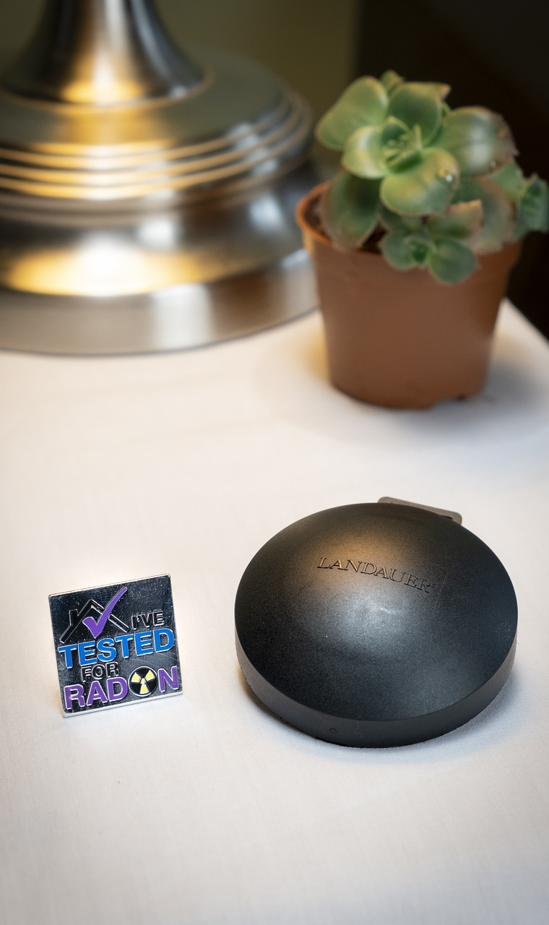
Next steps
Share what you’ve learned
Test your home

Slide 52
Thank you!
Images and graphics courtesy of Freepik, Unsplash, and Pixabay

